Slide 1
Modern Data Engineering in the Cloud
PART 4 : REALTIME STREAMING

Slide 2
Integration of Real-time Streaming and Data Science
Introduction to real-time data processing architectures - Lambda vs. Kappa
Introduction to and comparison of stream-processing frameworks
Kafka, Apache Spark, Flink, …
Introduction to Kafka and Kafka Streams - Architecture and Practical Exercises

Slide 3
Educational Objectives
Learn the main concepts of stream-processing
Understand the main difference between batch and stream-processing
Get familiar with popular stream-processing architectures
Get an overview of different streaming frameworks
First exposure to Kafka - the most widespread framework for streaming

Slide 4
Warm up
What is a stream? Where does it come from?
What is stream processing?
Why do we care?

Slide 5
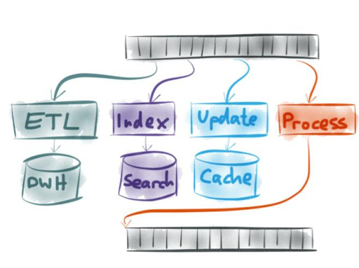
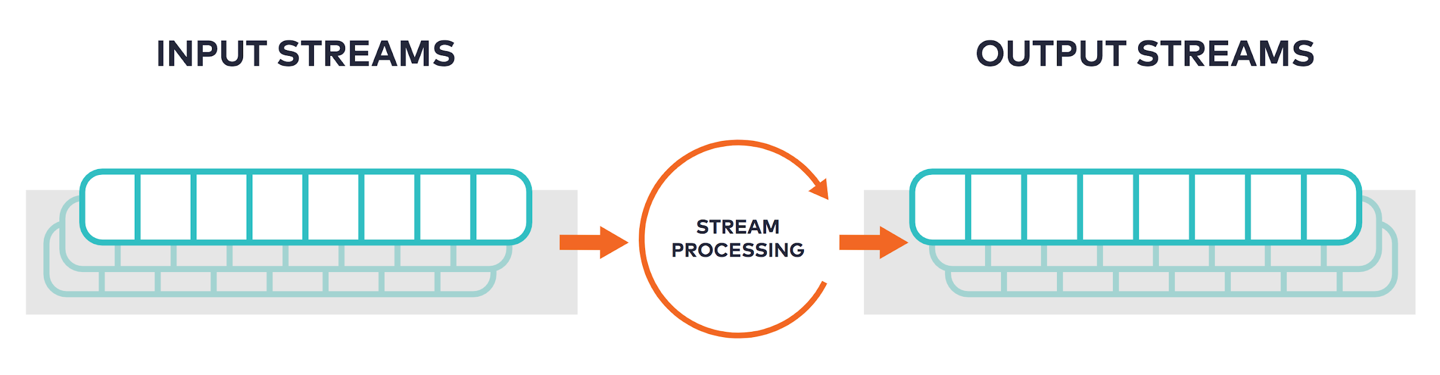
What is a stream? What is stream processing?
A stream is a continuous and unbounded sequence of input data
similar to how water flows through a river or a creek
Stream processing is the analysis of these data flows in “real-time” without the need to store the data first
The output of a stream-processing system is another stream that can be consumed by a variety of applications
Notes:
Image Sources
https://docs.ksqldb.io/en/latest/concepts/stream-processing/
http://www.igfasouza.com/blog/what-is-stream-processing/

Slide 6
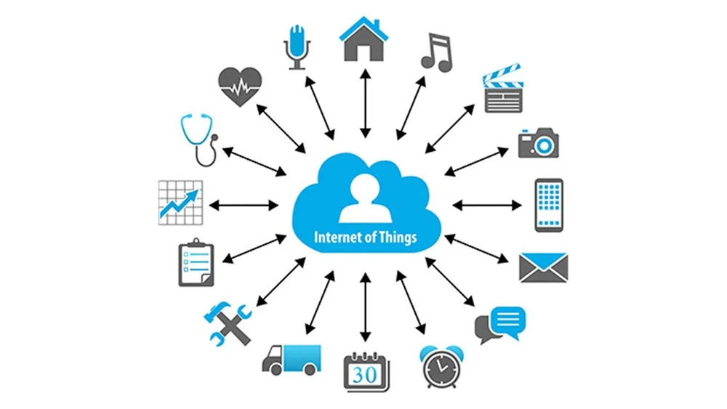
Main driver of stream-processing applications
We can generate unprecedented amounts of data than ever before
Multi-sensor devices are increasingly interconnected (Internet of Things)
Continuous data streams
Many companies need to:
receive data in real-time
learn from it
act on it immediately

Slide 7
Why do we care?
Just some examples
Cell phone networks (real-time networks logs to optimize network coverage)
Traffic networks (real-time sensor data for road-traffic monitoring)
Machine (predictive maintenance)
Trading Systems (algorithmic trading)
Social network data (link prediction, newsfeed curation)
Online advertising (dynamic personalized advertisement across contexts)
...

Slide 8
Batch vs Stream Processing Architectures
Batch processing
running high-latency, high-throughput, low-frequency, repetitive data jobs (e.g. queries) with minimal user interaction. Data is usually at rest
Stream processing
running low-latency, “high-throuhput”, repetitive data jobs on data in motion
Batch systems are optimized for static data and dynamic queries
e.g. load data once a day and enable efficient ad-hoc queries
able to pre-compute statistics and speed-up aggregation queries and some joins (materialized query tables)
Stream systems are optimized for dynamic data and static queries
Notes:
What can stream processing do and batch can’t? E.g.
Assume data streams from N machines. Join streams and compute stats every minute - batch systems do not efficiently process the join (need to align streams, events may be out of order, join needs to produce limited data from infinite streams)

Slide 9
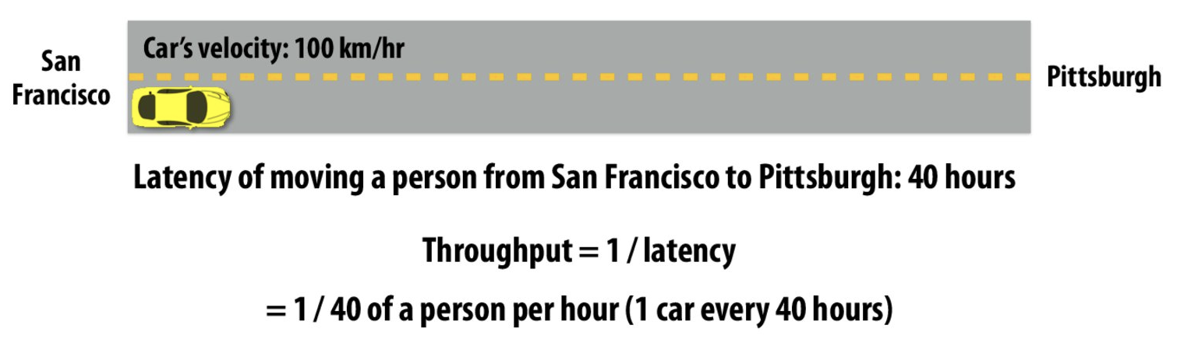
Latency vs Throughput
Latency - The amount of time needed for an operation (event) to complete
Throughput - Number of events per unit time (e.g. bandwidth)
How can we increase throughput?
Notes:
Image Source: http://15418.courses.cs.cmu.edu/spring2016/lecture/progperf2

Slide 10
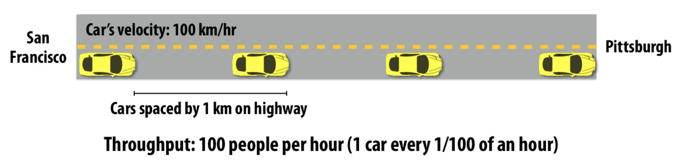
Latency vs Throughput
Latency - The amount of time needed for an operation (event) to complete
Throughput - Number of events per unit time (e.g. bandwidth)
How can we increase throughput? - more cars

Slide 11
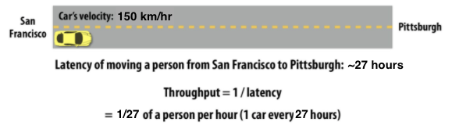
Latency vs Throughput
Latency - The amount of time needed for an operation (event) to complete
Throughput - Number of events per unit time (e.g. bandwidth)
How can we increase throughput? - one car, but drive faster

Slide 12
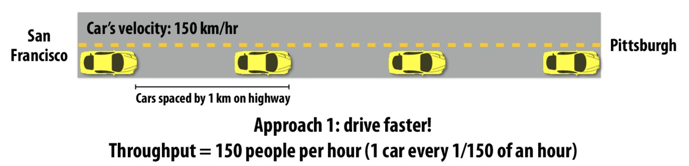
Latency vs Throughput
Latency - The amount of time needed for an operation (event) to complete
Throughput - Number of events per unit time (e.g. bandwidth)
How can we increase throughput? - more cars, drive faster

Slide 13

Modern Data Architectures - Lambda
“An approach to implement an arbitrary function on an arbitrary dataset and having the function return its result with low latency”
All clear? Good, we’re done!
Notes:
Sources:
http://lambda-architecture.net/

Slide 14
Modern Data Architectures - Lambda
“An approach to implement an arbitrary function on an arbitrary dataset and having the function return its result with low latency”
Arbitrary functions on arbitrary datasets:
number of unique users per minute
number of bookings per minute
most popular search terms
trending tweets
user reputation
current friend list
Notes:
Sources:
http://lambda-architecture.net/

Slide 15
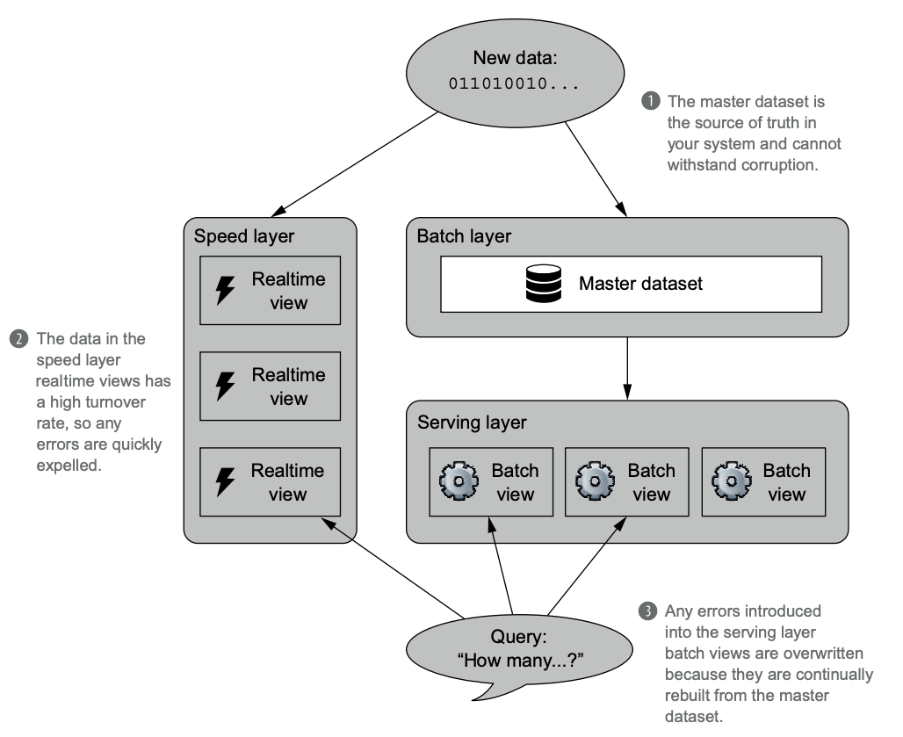
Modern Data Architectures - Lambda
New data fed to the Batch (historical) and Speed (real-time) Layers simultaneously
The Batch layer stores all data, pre-computes batch views and maintains the master dataset
The Speed layer performs real-time operations on recent data only and drops the rest
The Serving Layer indexes the batch views, so that they can be queried in a low-latency, ad-hoc way
Notes:
Source: https://databricks.com/glossary/lambda-architecture
Source: https://www.merlin.uzh.ch/contributionDocument/download/7275

Slide 16
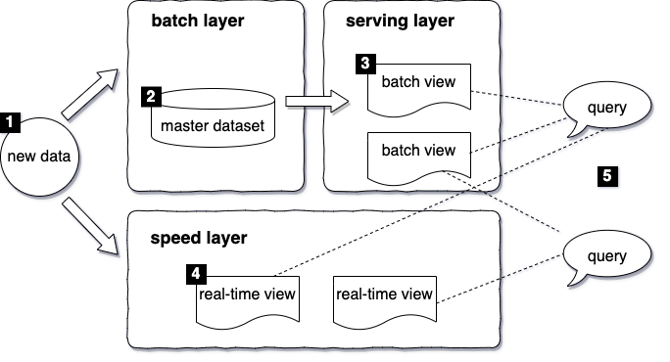
Modern Data Architectures - Lambda
New data fed to the Batch (historical) and Speed (real-time) Layers simultaneously
The Batch layer stores all data, pre-computes batch views and maintains the master dataset
The Speed layer performs real-time operations on recent data only and drops the rest
The Serving Layer indexes the batch views, so that they can be queried in a low-latency, ad-hoc way
Notes:
Source: https://databricks.com/glossary/lambda-architecture
Source: https://www.merlin.uzh.ch/contributionDocument/download/7275

Slide 17
Lambda Architecture - Case Study WebShop
For our webshop we need to provide a dashboard (one of potentially many) with:
How many unique users visited each URL in 2010? In the past hour?
Query: Return unique visitors by URL for a given time range
Notes:
Source: https://databricks.com/glossary/lambda-architecture
Source: https://www.merlin.uzh.ch/contributionDocument/download/7275

Slide 18
Lambda Architecture - Batch Layer
Example Batch View for storing hourly granularity:
URL | Hour | # Unique Users | Unique Users
foo.com/blog | 2020/01/01 15:00 | 101 | 1,3,7, ...
foo.com/blog | 2020/01/01 16:00 | 103 | 13,15,33, ...
foo.com/blog | 2020/01/01 17:00 | 105 | 1,3,5, ….
foo.com/blog | 2020/01/01 18:00 | 95 | 2,4,33, ...
Function: sum
Result

Slide 19
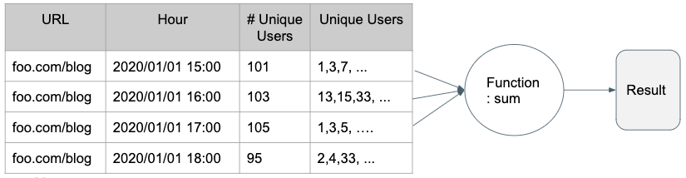
Lambda Architecture - Batch Layer
Is one hourly batch view enough for all possible arbitrary functions?

Slide 20
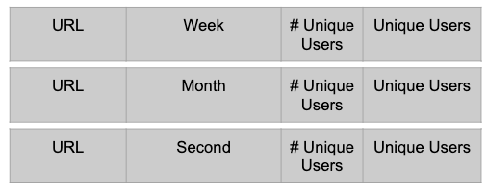
Lambda Architecture - Batch Layer
Is one hourly batch view enough for all possible arbitrary functions?
Arbitrary time ranges

Slide 21
Lambda Architecture - Batch Layer
Is one hourly batch view enough for all possible arbitrary functions?
Arbitrary time ranges
What about latency? How fast can we compute a query?

Slide 22
Lambda Architecture - Serving Layer
The Serving layer indexes the batch views, so that they are actually useful
Tightly coupled with the Batch Layer - Batch continuously updates the views
The Serving Layer views will always be out of date. Why?
Serving Layer is the only layer where tooling lacks behind the theory

Slide 23
Lambda Architecture - Serving Layer
How do we index that?

Slide 24
Lambda Architecture - Serving Layer
How do we index that?
key-value pair?
Partitioned Key |  | Value
URL | Hour | # Unique Users | Unique Users
foo.com/blog | 2020/01/01 15:00 | 101 | 1,3,7, ...
foo.com/blog | 2020/01/01 16:00 | 103 | 13,15,33, ...
foo.com/blog | 2020/01/01 17:00 | 105 | 1,3,5, ….
foo.com/blog | 2020/01/01 18:00 | 95 | 2,4,33, ...
each partition (color) resides on a different server
is this the best indexing strategy? what about response time?

Slide 25
Lambda Architecture - Serving Layer
How do we index that?
sorted key-value pair?
Partitioned Key |  | Value
URL | Hour | # Unique Users | Unique Users
foo.com/blog | 2020/01/01 15:00 | 101 | 1,3,7, ...
foo.com/blog | 2020/01/01 16:00 | 103 | 13,15,33, ...
foo.com/blog | 2020/01/01 17:00 | 105 | 1,3,5, ….
foo.com/blog | 2020/01/01 18:00 | 95 | 2,4,33, ...
store all partitions for a given key on the same server
promotes scan instead of disk seek operations

Slide 26
Lambda Architecture - Speed Layer
Main job is the same as Batch and Serving layers - produce views that can be efficiently queried
Views only represent “recent” data
The Speed layer is the domain of incremental algorithms and stream processing (i.e. update views instead of recompute)
The Speed layer requires random-read/random-write databases, so that updates can be performed on existing views

Slide 27
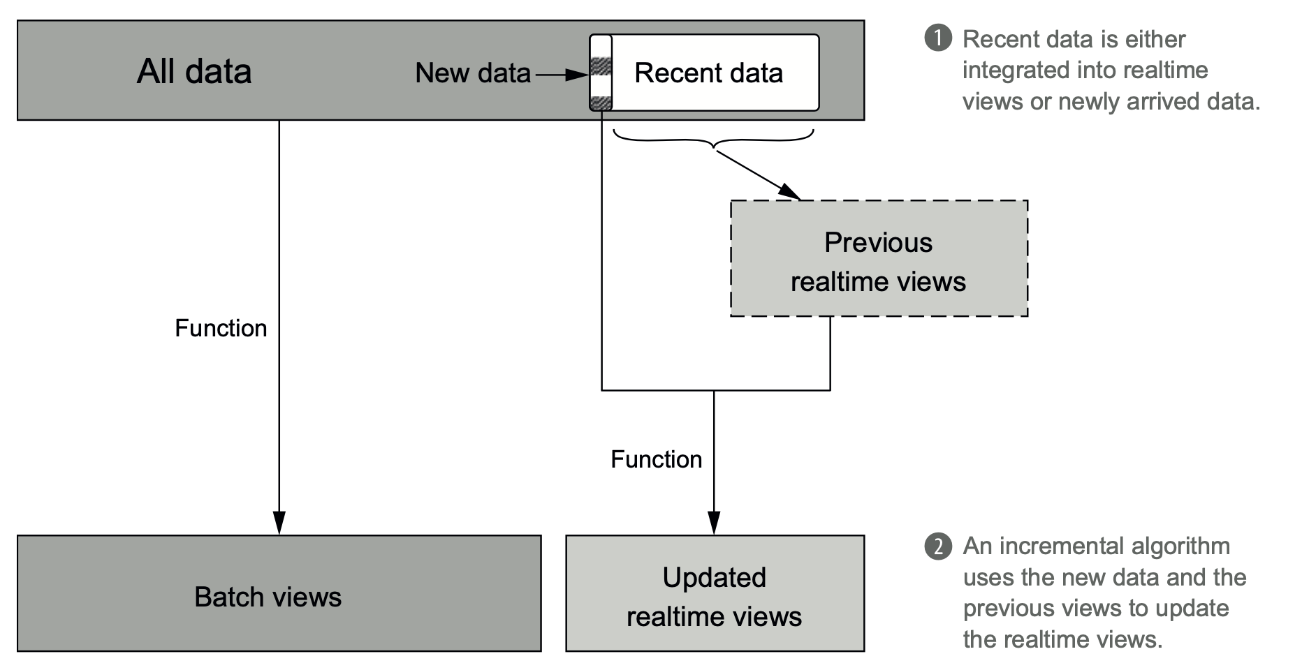

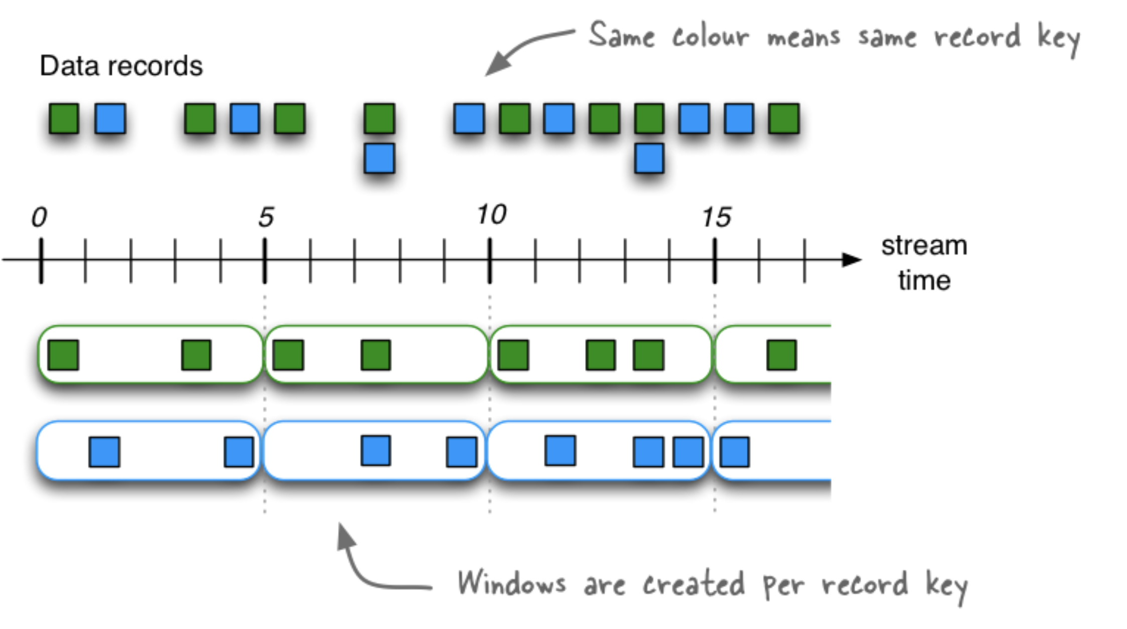
Lambda Architecture - Speed Layer
Random-read/random-write databases that are also scalable and support arbitrary data models are properties of a new class of databases - NoSQL
Partitioned Key |  | Value
recent URL | recent Time | # Unique Users | Hyperlog Set
foo.com/blog | every 5 mins | 101
foo.com/blog | every 5 mins | 103
foo.com/blog | every 5 mins | 105
foo.com/blog | every 5 mins | 95
Notes:
Image source: https://kafka.apache.org/20/documentation/streams/developer-guide/dsl-api.html

Slide 28
Lambda Architecture - Summary
Batch Layer
typically a data lake (Hadoop) built on a distributed file system, like HDFS
Serving Layer
can be implemented using NoSQL technologies, like MongoDB, HBase, Apache Druid, etc.
Speed Layer
can be implemented with data streaming technologies, such as Apache Storm, Apache Samza, Kafka Streams, Spark Streaming, etc.
Notes:
Reprocessing is a very underestimated use case

Slide 29
Lambda Architecture - Summary
Advantages
Emphasizes retaining the raw input data → re-processing is possible (unlike pure stream processing)
Enables complex use cases that are a combination of a scalable high-latency system (batch) with low-latency approximately correct system (stream)
Disadvantages
Need to maintain the same logic in two different systems. Even worse - need to implement the same code in different systems.
Results in high operational complexity to set-up, operate and debug
Ultimately duct-taping highly complex technologies together (batch + stream) results in overall complexity that easily becomes unmanageable.
Notes:
Reprocessing is a very underestimated use case

Slide 30

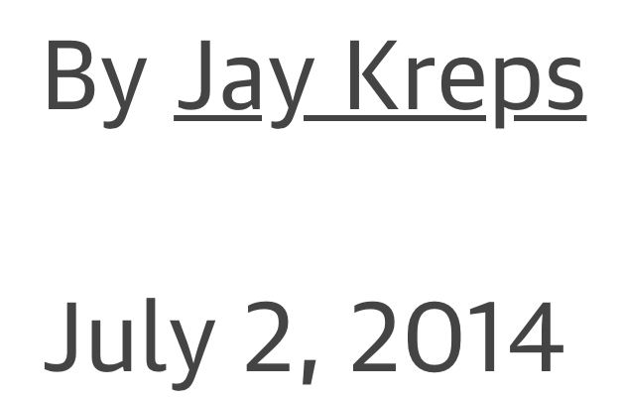
Modern Data Architectures - Kappa
Transformation logic is implemented twice - error prone and very complex
Lambda (duct-taping) is only a temporary solution to achieving complex, low-latency, high-throughput and scalable pipelines that can re-process data. When streaming technologies mature, Lambda will become obsolete.
Why can’t the Streaming layer be improved the handle low-latency and high-throughput use cases?
well… it can.
https://www.oreilly.com/radar/questioning-the-lambda-architecture
Notes:
Source: https://milinda.pathirage.org/kappa-architecture.com/
Spectrum: a scalable high-latency batch system that can process historical data and a low-latency stream processing system that can’t reprocess results. By duct taping these two things together, they can actually build a working solution.

Slide 31
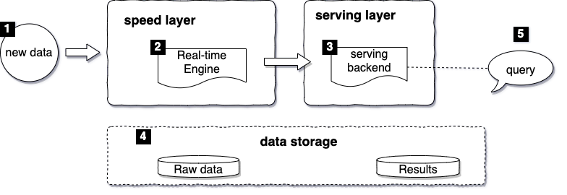
Modern Data Architectures - Kappa
Simplified Lambda: everything is a continuous and unbounded stream
Canonical data store is an append-only immutable log. No NoSQL databases
Replay historical data as a stream - high-throughput + low latency
The ultimate domain of stream processing
Notes:
Source: https://milinda.pathirage.org/kappa-architecture.com/
http://martinfeick.com/wp-content/uploads/2018/07/Fundamentals-of-Real-Time-Data-Processing-Architectures-Lambda-and-Kappa.pdf

Slide 32
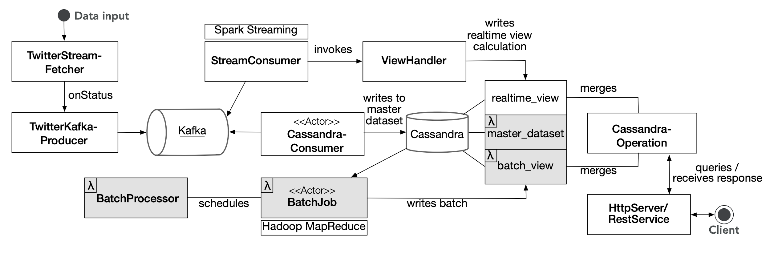
Modern Data Architectures - Kappa in reality
Notes:
Image Source: http://martinfeick.com/wp-content/uploads/2018/07/Fundamentals-of-Real-Time-Data-Processing-Architectures-Lambda-and-Kappa.pdf

Slide 33
Kappa Architecture - Summary
Advantages
A code base that is leaner, easier to maintain, debug and operate
One single technology for batch and streaming workloads
Easy to scale horizontally
Disadvantages
Designed with the notion of log processing. Harder to implement in more complex scenarios with large message sizes (think image processing)
Streaming technologies are not yet mature to support the vision of Kappa
In reality it is very hard to completely avoid a batch database
Notes:
Interesting read on the cons of Kappa:
https://www.linkedin.com/pulse/trouble-kappa-architecture-michael-segel/

Slide 34
Stream processing frameworks
Framework | Advantages | Disadvantages
Apache Storm | - Very low latency & high throughput - Native streaming - Good for non-complicated streaming use cases | - No state management - No event time processing, aggregation, windowing, sessions, watermarks - At least-once delivery guarantee
Spark Streaming | - Supports Lambda architecture - Uses Spark core - High throughput with adequate latency - Big community - Exactly once delivery guarantee | - Not suitable for sub-second latencies - Too many parameters to tune
Apache Flink | - First native streaming framework with all advanced features - Low latency & high throughput - Exactly once delivery guarantee - Auto adjusting, not too many tuning parameters | - Small community - Only popular for streaming, no adoption for batch - Not a lot of traction, despite some adoption by big tech (Uber, Alibaba)
Apache Samza | - Fits well in the Hadoop ecosystem - Low latency & high throughput - Mature and tested at scale - Good in maintaining large state information | - Tightly coupled with Kafka and Yarn. Not easy to use if either of these is not available - At least-once delivery guarantee - Lack of advanced features like Watermakrs, Sessions, event-time processing
Kafka Streams | High-throughput, low-latency, fault tolerant Distributed highly scalable True streaming + batch capabilities + state management exactly once delivery guarantee Enterprise grade, wide spread | - No multitenancy, security groups, isolation - No resource management (throttling, quotas)

Slide 35
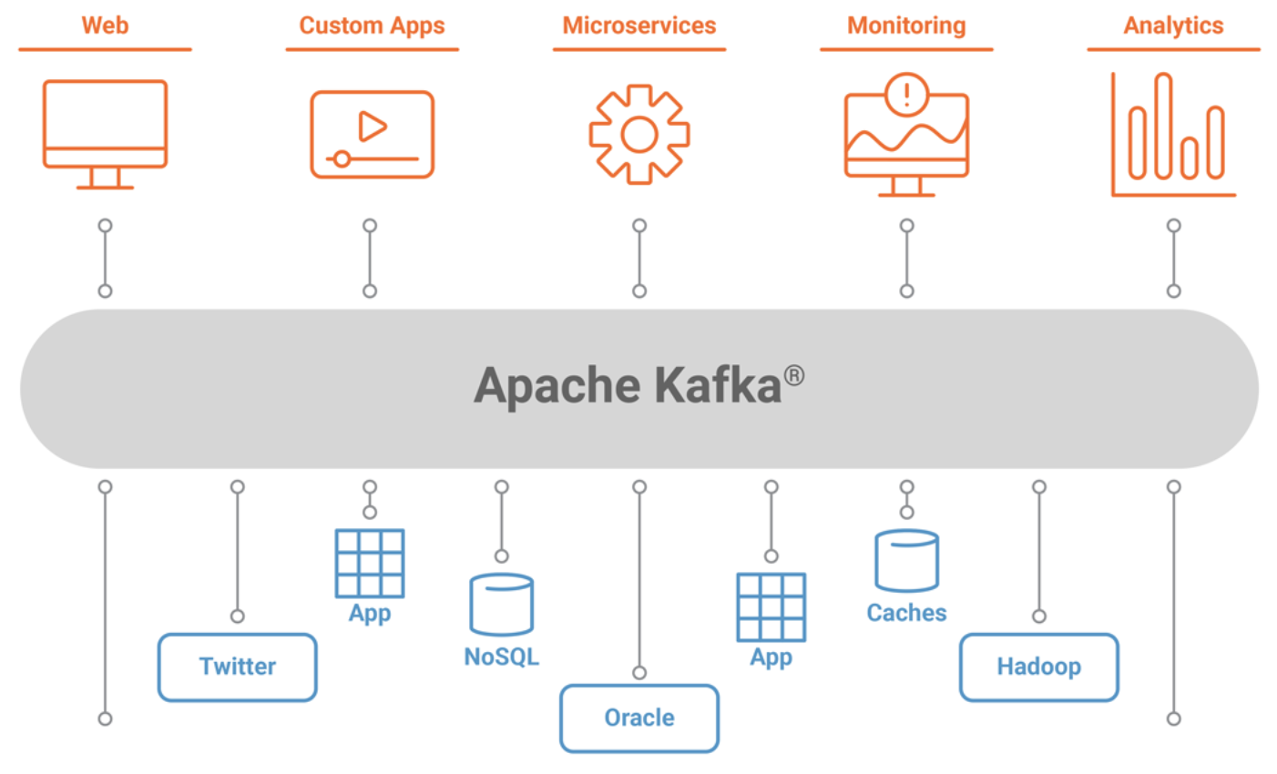
Apache Kafka
Apache Kafka is a publish-subscribe message system - processes, applications and devices send messages among each other
It is a fast (low-latency) distributed streaming platform capable of handling trillions of events a day
Originally developed by Jay Kreps in LinkedIn and open-sourced in 2011
named after Franz Kafka because it is optimized for writing and Jay liked Kafka’s writing
Notes:
Image Source: https://docs.confluent.io/current/kafka/introduction.html

Slide 36
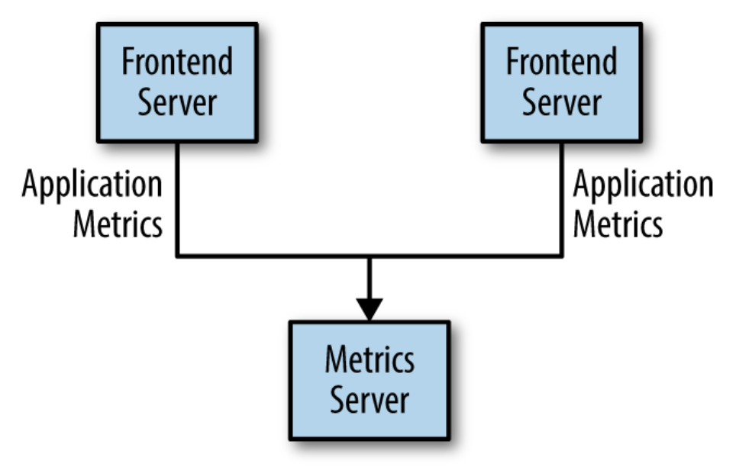
Apache Kafka
How do applications communicate with each other?
direct
An application (Frontend Server) sends metrics (nr. users, nr. clicks) to a real-time Dashboard
Simple and intuitive architecture
What problems may arise as we scale?
Notes:
Image Source: https://docs.confluent.io/current/kafka/introduction.html

Slide 37
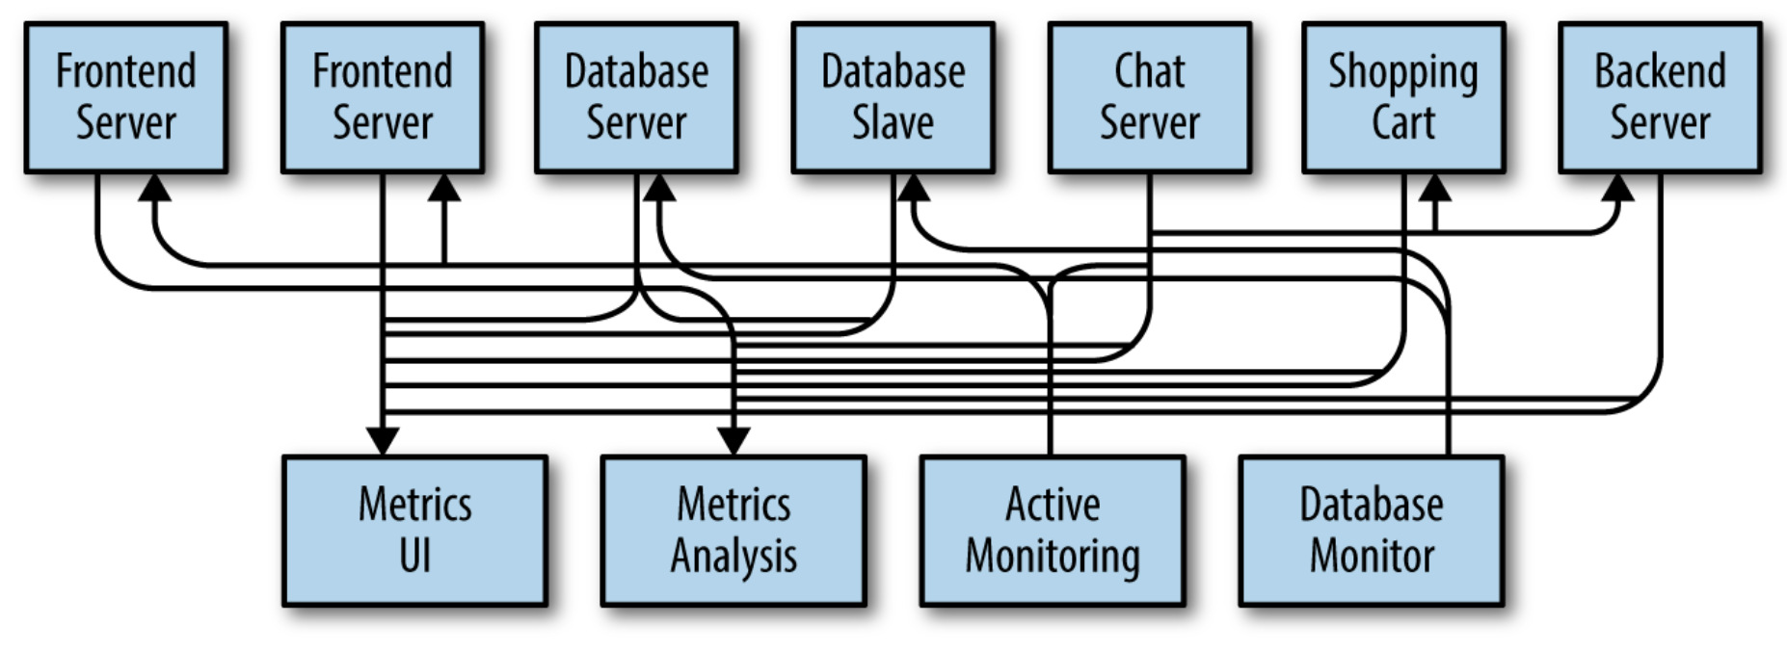
Apache Kafka
What if we want to do Analytics on the metrics?
real-time dashboard is not suitable
In the meantime more applications have joined in to send their metrics to the dashboard (Database, Chat, Shopping Cart)
There is now a need to keep track of the performance of all applications for active alerting (Active Monitoring)
Notes:
Image Source: https://docs.confluent.io/current/kafka/introduction.html

Slide 38
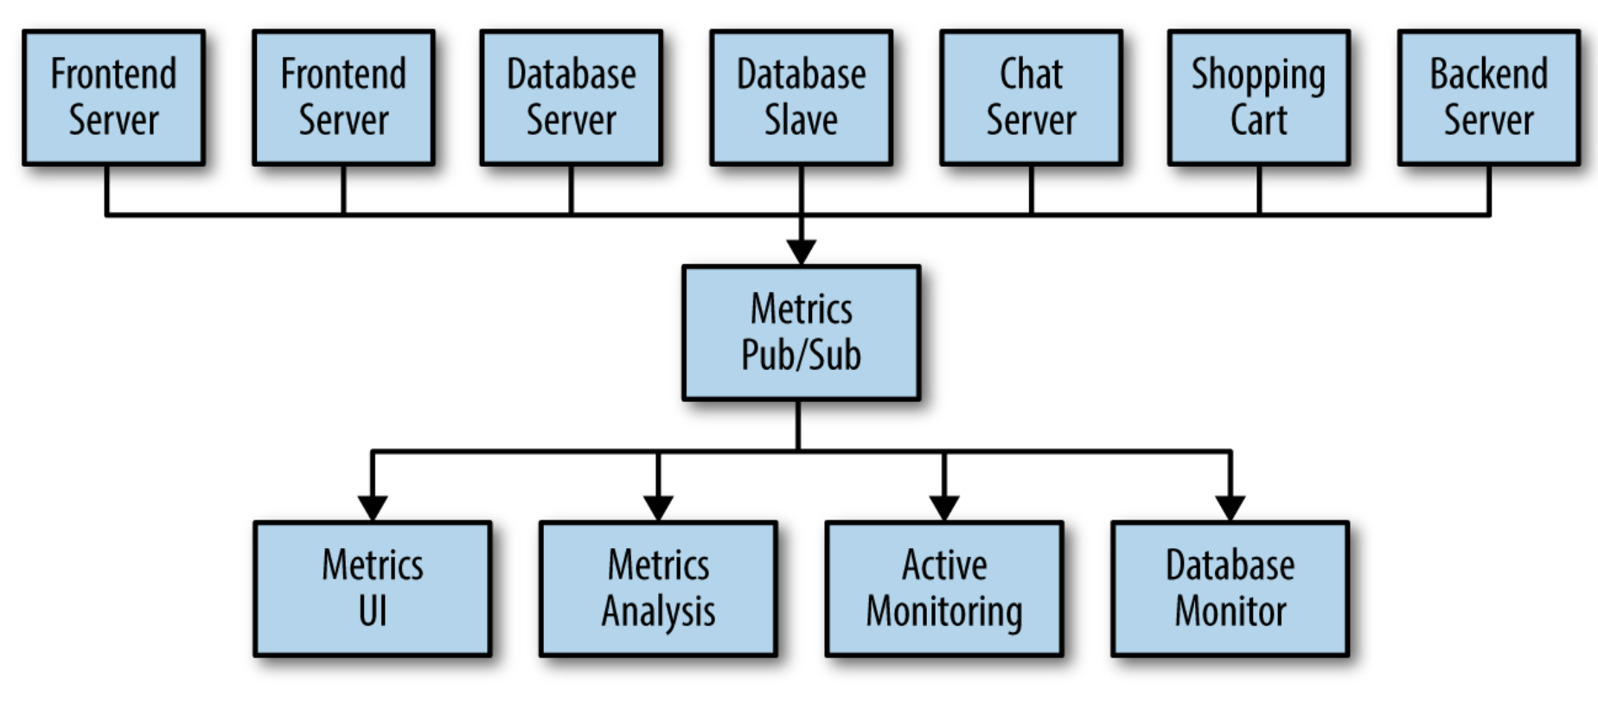
Apache Kafka
Direct communication does not scale well. Is there a better way?
Yes - go through an intermediary
An intermediary broker receives all metrics messages and delivers them to any application that requests them
Congratulations - we have built our first publish-subscribe system
Notes:
Image Source: https://docs.confluent.io/current/kafka/introduction.html

Slide 39
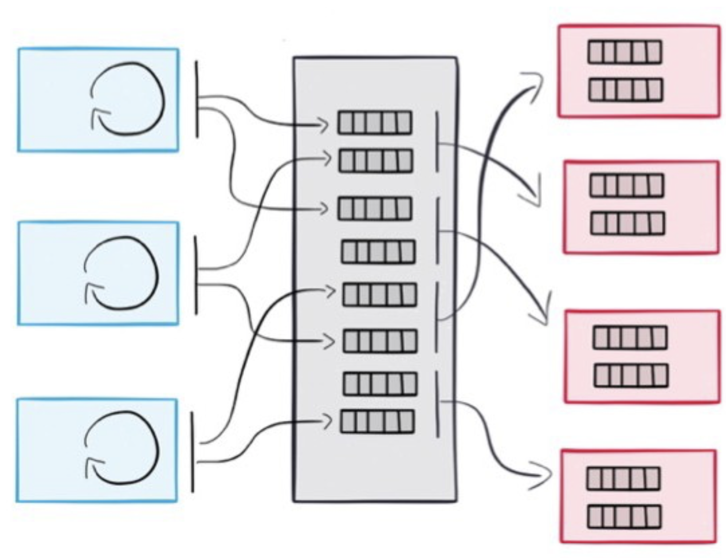
Decoupling Producers and Consumers
Slow Consumers do not affect Producers
We can add Consumers without affecting Producers
Producers and Consumers can operate at different processing speeds
Failure of a Consumer or a Producer does not affect the system
Notes:
Consumers and Producers are this decoupled

Slide 40
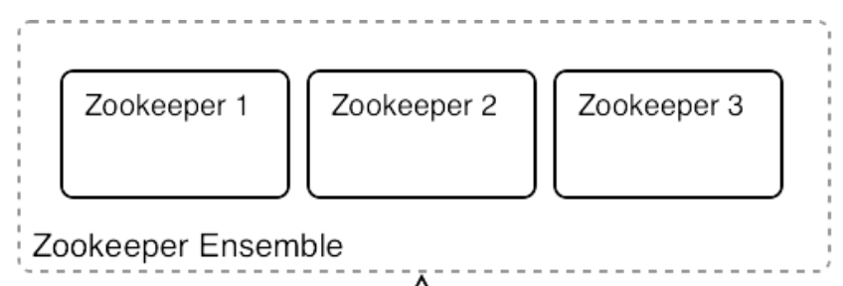
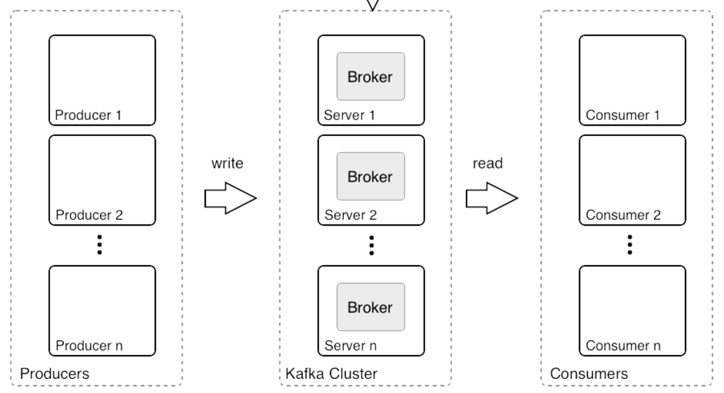
Apache Kafka - Publish-Subscribe Messaging System
distributed Key Value Store
Maintains configuration information
Provides distributed synchronization
Odd number of nodes
Failure detection & recovery
Store ACLs & secrets
Notes:
Consumers and Producers are this decoupled

Slide 41
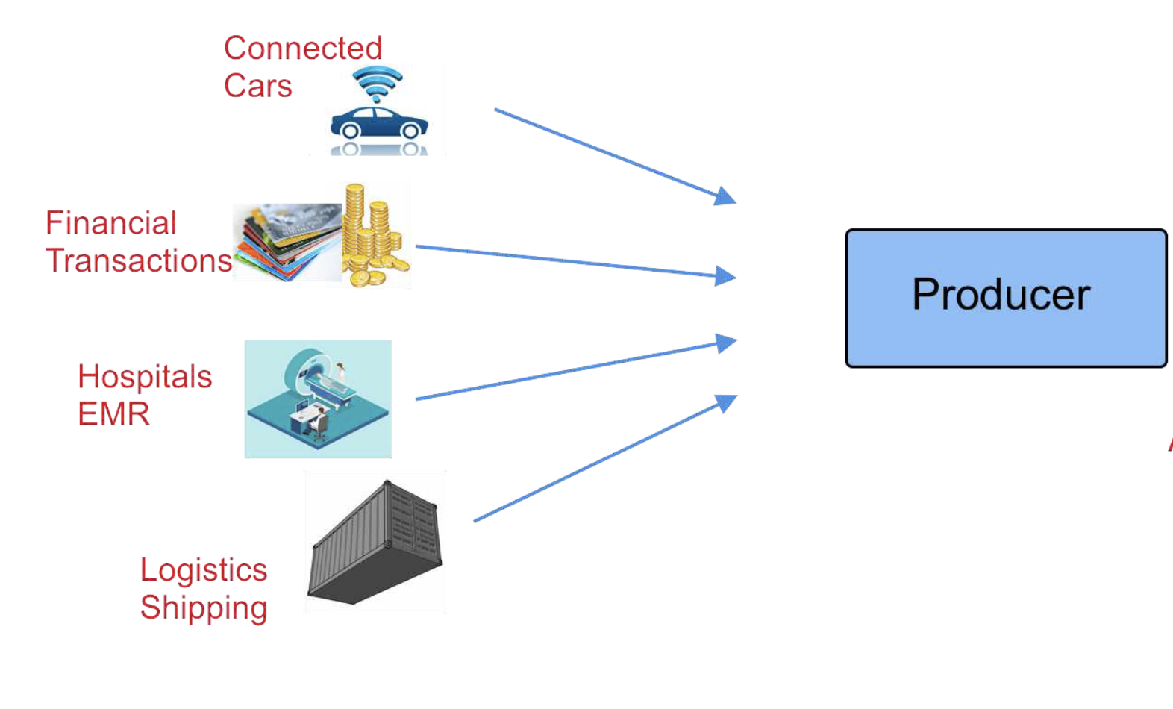
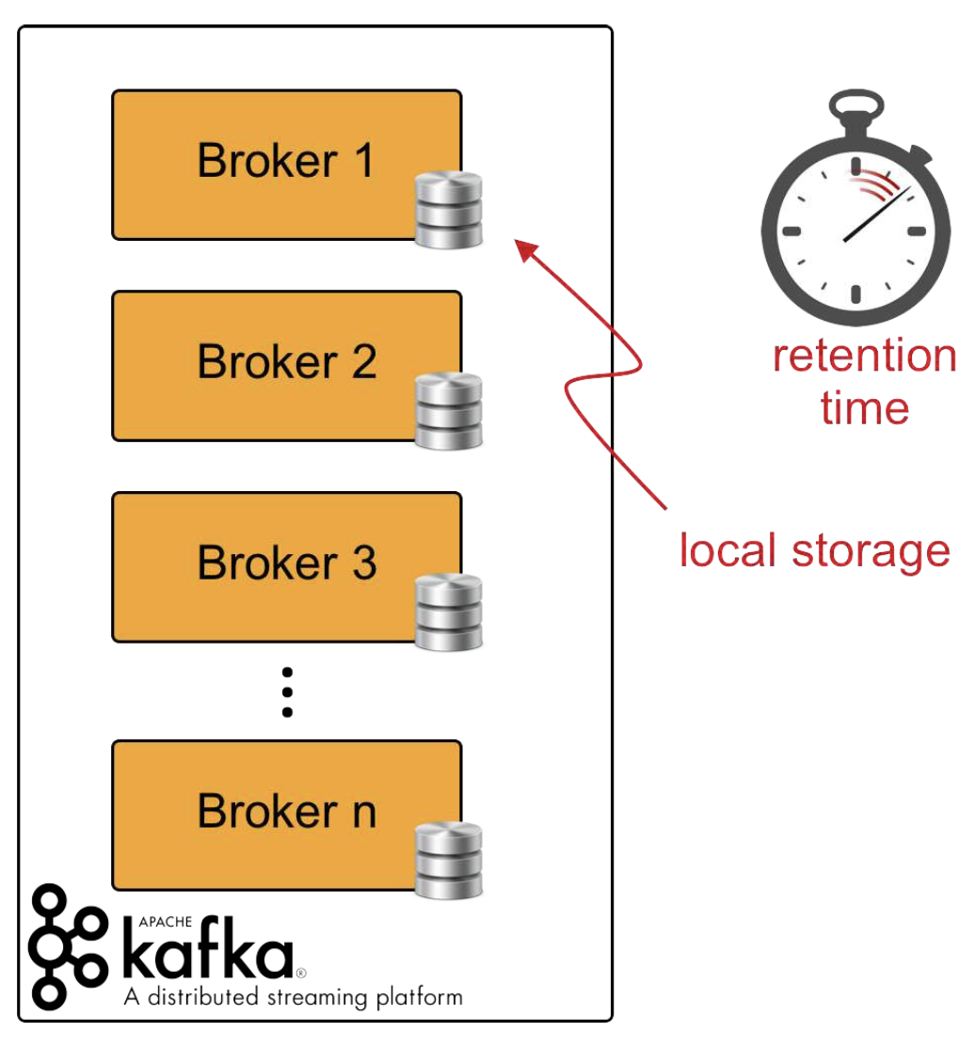
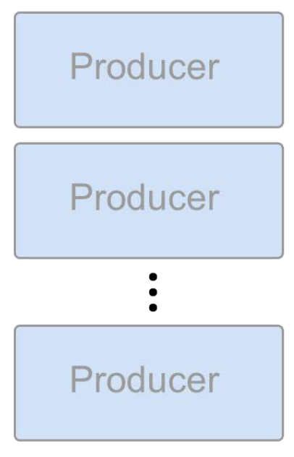
Apache Kafka - Producers
Send messages to a Kafka broker on a specific topic
Broker keeps the messages for a certain time in local storage
Consumers subscribe to topics and get informed about new messages
send data
Notes:
I

Slide 42
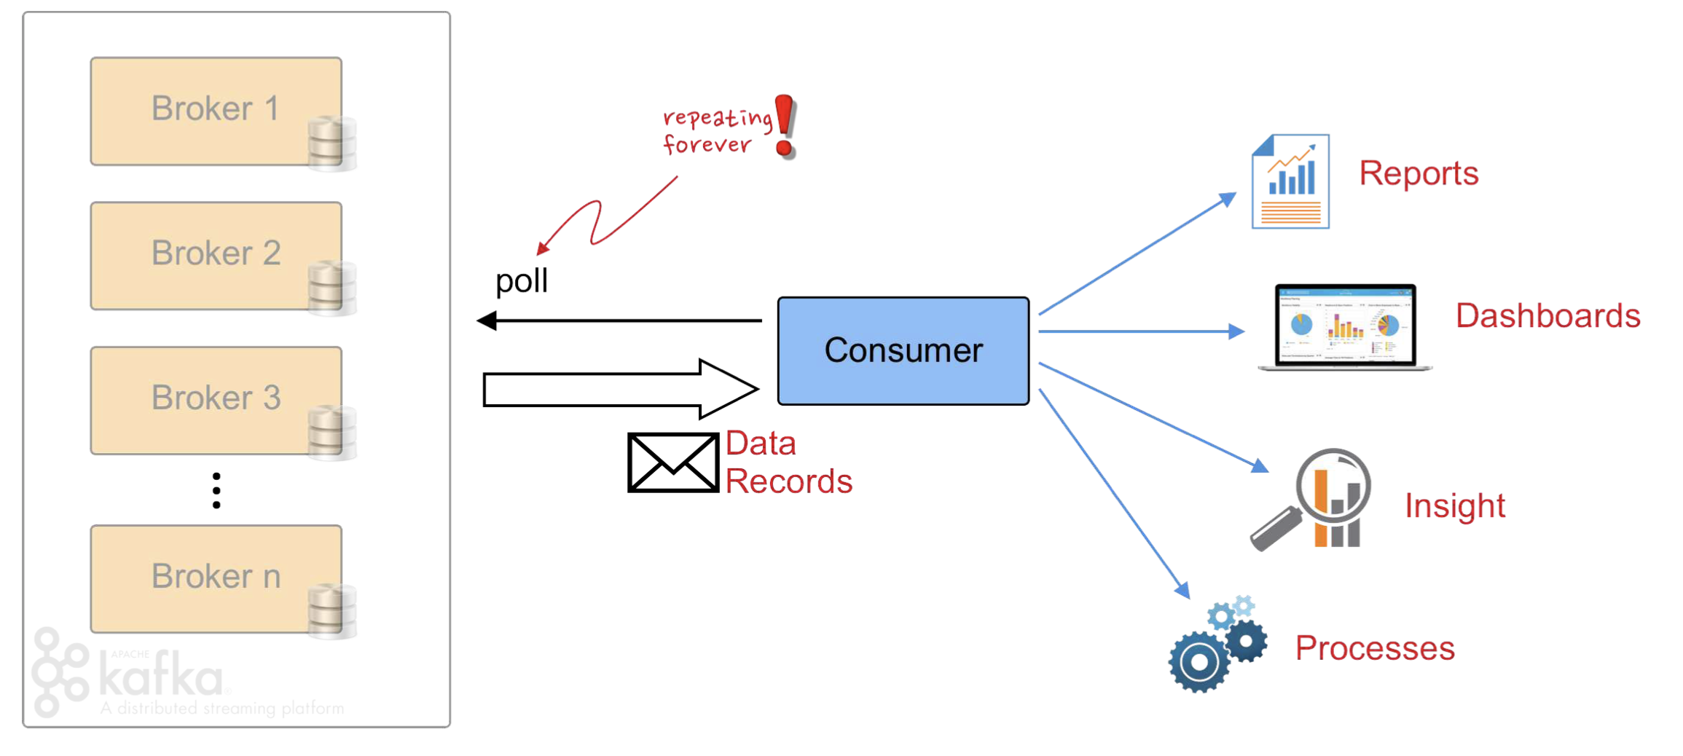
Apache Kafka - Consumers
subscribe to a topic and receive messages from this topic only
multiple consumers can be subscribed to the same topic
how are messages distributed across the consumers (consumer groups)
Notes:
I

Slide 43
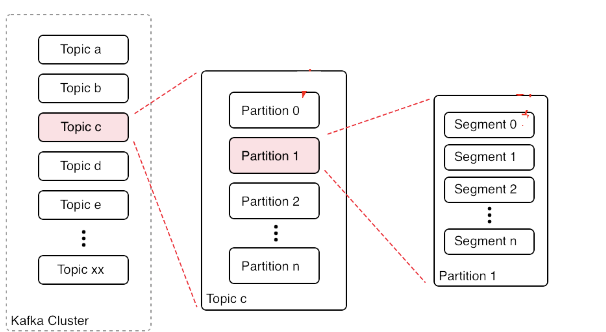
Apache Kafka - Topics
A topic is a user-defined category for a message - e.g. “metrics”, “alerts”
A topic is part of the metadata of the message
A topic is further split into different partitions
The partition is the unit of storage of a Kafka broker
Notes:
I

Slide 44
Apache Kafka - Partitions
A partition is typically replicated in a multi-broker set-up
A partition replica is the basic storage unit of Kafka
Partitions cannot be split across multiple-brokers nor even across multiple disks in the same broker
Partition is stored in log.dirs - list of directories
a Segment is a file
default: size is 1GB or a week of data, whichever comes first
consists of Messages
Notes:
I

Slide 45
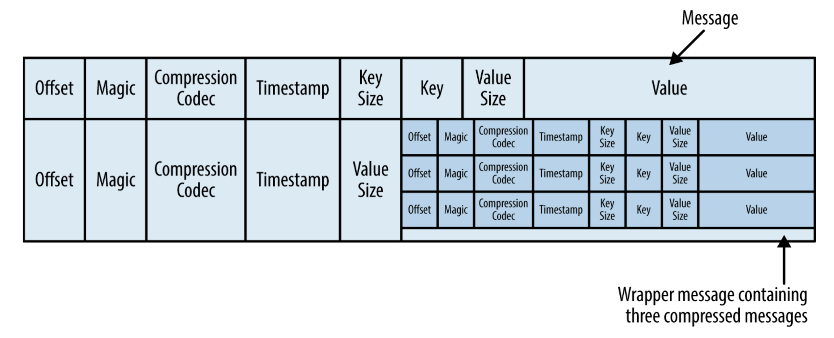
Apache Kafka - Message Format
A Message is simply a string of bytes
Kafka supports compressed and “normal” messages
Compressed messages are a batch of normal messages send as a chunk by the producer
Compressed messages are stored in a wrapper message
Notes:
Show raw message data in Confluence Control Center and also
/home/ubuntu/kafka/kafka_2.12-2.5.0/bin/kafka-run-class.sh kafka.tools.DumpLogSegments --deep-iteration --print-data-log --files /var/lib/kafka/data/wikimedia_stream-1/00000000000000000000.log | less

Slide 46
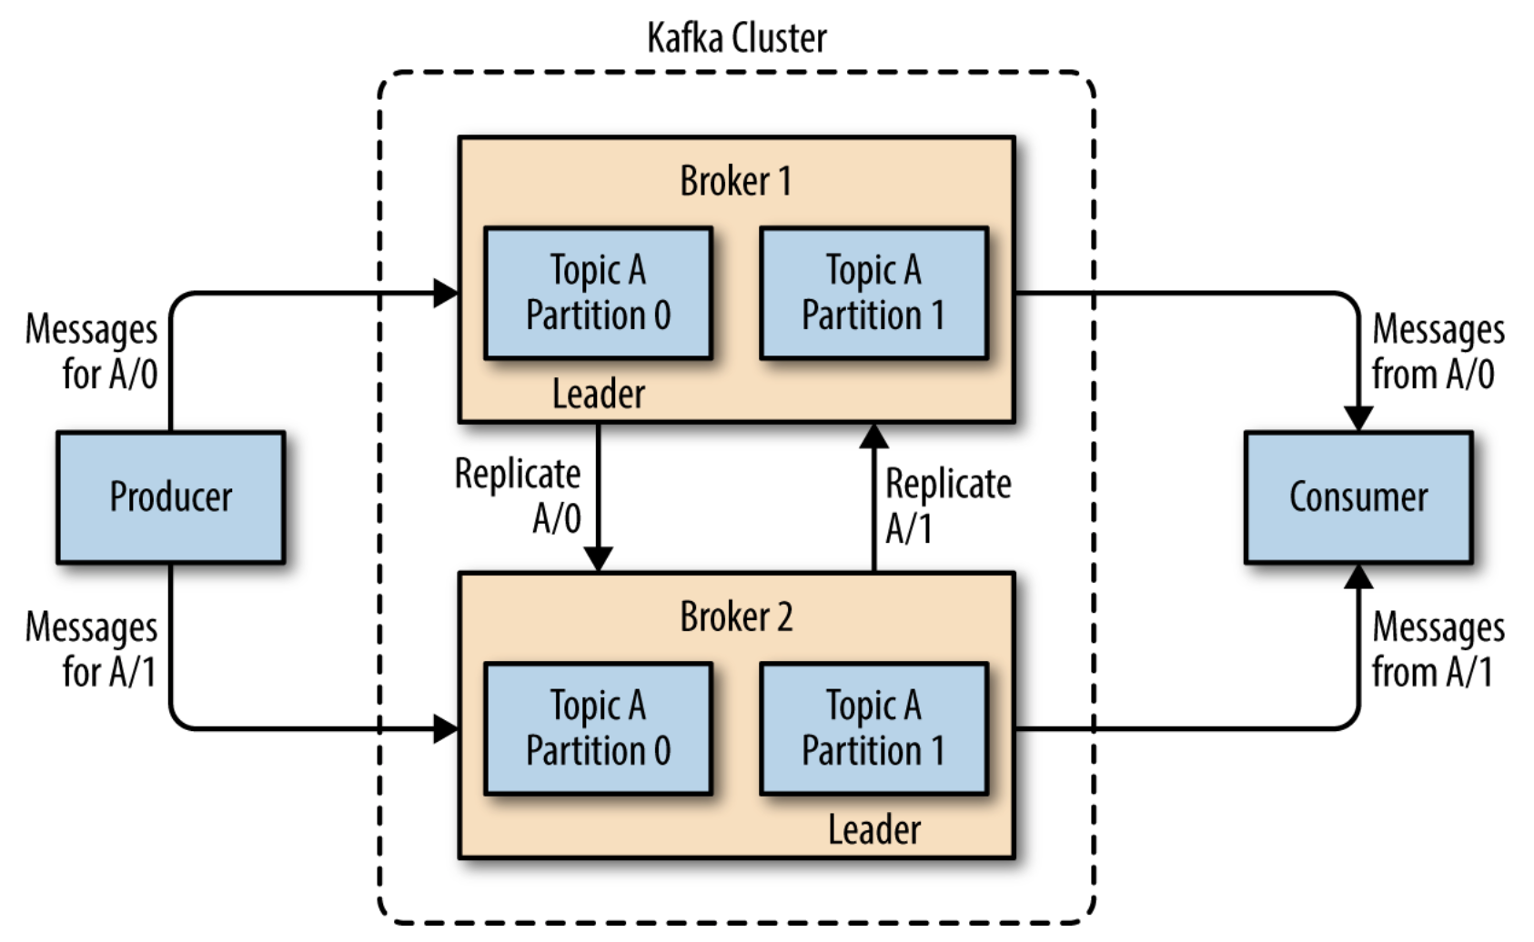
Apache Kafka
Publish-Subscribe
a message Producer publishes a message to a Broker on a certain topic
the message does not have a dedicated recipient
a Consumer subscribes to the Broker on a certain topic
the Broker delivers messages to Consumers only from the topics they are subscribed to
Notes:
Consumers and Producers are this decoupled

Slide 47
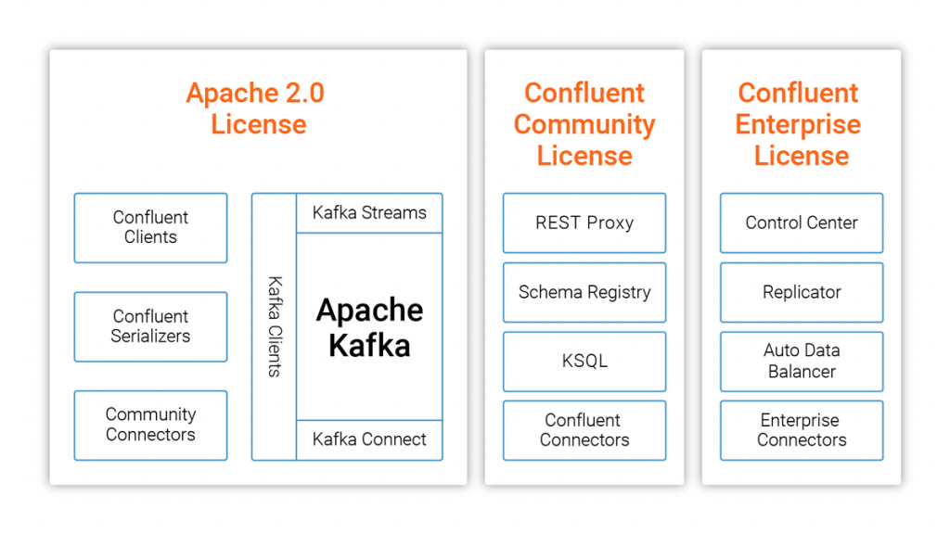
Confluent Kafka
User friendly and enterprise-ready Kafka Installation
Founded by the team that originally created Apache Kafka
Includes many useful services in addition to vanilla Kafka
Notes:
Demo: Showcase Confluent Control Center

Slide 48
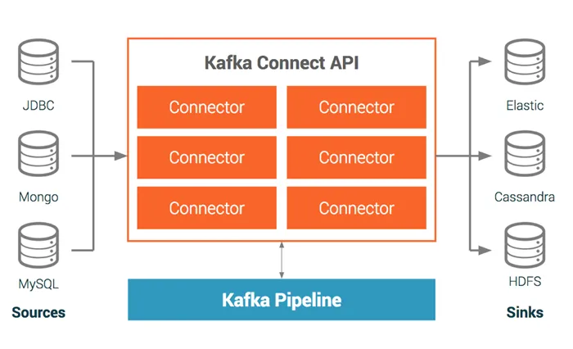
Confluent Kafka - Kafka Connectors
A framework for connecting Kafka with external systems
Provides connectors to various databases, key-value stores, streams
A marketplace for connectors - https://www.confluent.io/hub/
Notes:
Market place - https://www.confluent.io/hub/

Slide 49
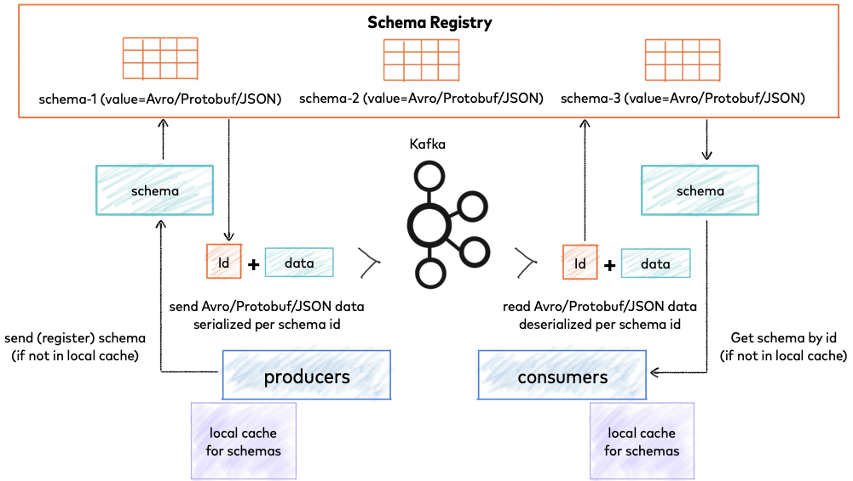
Confluent Kafka - Schema Registry
Stores a versioned history of all schemas
Producers and Consumers still talk to Kafka brokers, but they can also talk to the Schema Registry to send and retrieve schemas that describe the data models for the messages
Notes:
Image Source: https://docs.confluent.io/current/schema-registry/index.html

Slide 50
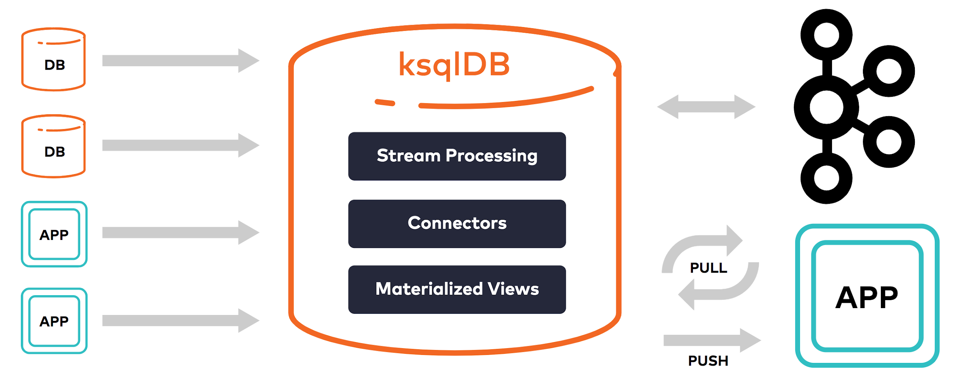
Confluent Kafka - ksqlDB and KSQL
An event-streaming database specifically build for stream processing applications
build applications that react immediately to events
build materiliazed views over streams
Notes:
Image Source: https://docs.confluent.io/current/schema-registry/index.html

Slide 51
Apache Kafka - Check your understanding
What is the main disadvantage of the Lambda architecture
How many Kafka brokers can a cluster maximally have?
How many Kafka brokers do we minimally need to high availability?
What is a topic and a partition?
How do messages get assigned to a specific topic? What about a specific partition?
How can a consumer restart from the point of failure and consume only new messages?
What is the criteria that two or more consumers form a consumer group?

